Slide 1
Welcome to
Air Force Financial Readiness:
Your Post-Deployment Flight Plan
Personal Financial Readiness

Slide 2


Agenda
Financial Planning
Post-Deployment
Smooth Landing Checklist

Slide 3

Financial Planning Post-Deployment

Slide 4

Factor in Changes
Increase/decrease in pay, allowances, allotments, and others
Changes in dependents (birth, divorce)
Changes in expenses
Notes:
Animation – 2 clicks

Slide 5









Reassess Financial Goals
Insurance Premiums
Car Repairs
Home Maintenance
Holiday Gifts
Trips
Taxes
Maximize Matching: Contribute 5% to Your TSP Account!
Notes:
Animation – 1 click

Slide 6


Plan Major Purchases
Pay off debt
Invest in retirement through TSP, earning all available matching contributions
Start a college fund
Fund the down payment for a house
Buy a car

Slide 7




Make a Workable Plan
Notes:
Images appear one-by-one upon accessing the slide.

Slide 8

Smooth Landing Checklist

Slide 9

Estate Planning Documents
Review and update:
  Your will
  Insurance policy beneficiaries
Revoke POA
Contact base legal office
Armed Forces Legal Assistance Locator
https://legalassistance.law.af.mil
Notes:
Animation – 1 click

Slide 10






Servicemembers Civil Relief Act
Cell phone contracts
Automobile leases
Residential leases
6% interest
Court proceedings
Taxes and liabilities

Slide 11

Savings Deposit Program
Emergency fund
Investments
Major purchase
Notes:
Animation – 1 click

Slide 12
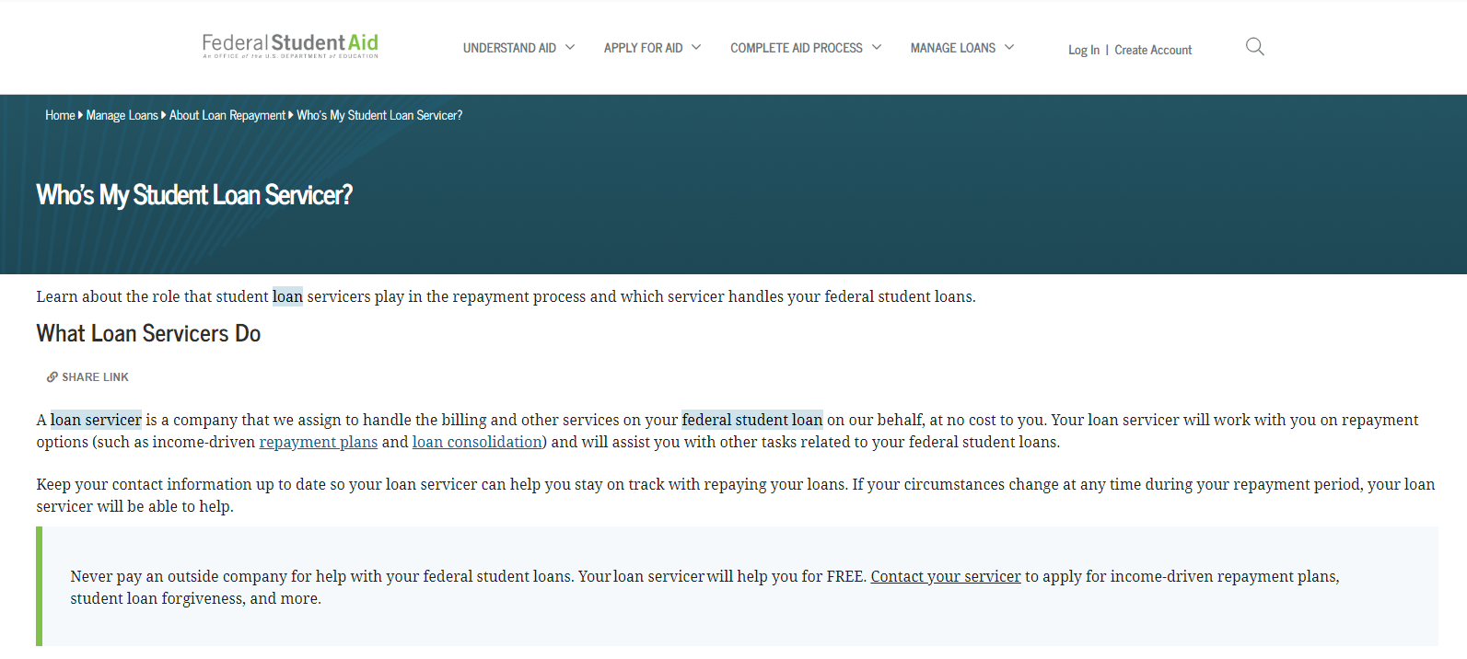
Student Loan Interest Relief
0% Interest
HEROES Act Waiver
Studentaid.gov
Notes:
Animation – 2 clicks

Slide 13

Medical Coverage
TRICARE may cover Guard/Reserve and family members for 180 days after release from active duty (See your FSS)
TRICARE Reserve Select (TRS) coverage may be purchased
Update civilian coverage as necessary
Notes:
Animation -3 clicks

Slide 14

Life Insurance
Change SGLI/FSGLI beneficiaries to reflect change in family structure
Do you have enough insurance?
Consider:
Current indebtedness
Transition costs for spouse
College for children
Review often. Needs do change.
Notes:
Animation – 3 clicks

Slide 15

Auto and Property Insurance
Notify insurer car is “on the road”
Update property insurance to include new purchases

Slide 16

Taxes
Verify filing responsibilities and deadlines
Review IRS Publication 3: Armed Forces Tax Guide

Slide 17



Active Duty Alerts
1-888-397-3742
1-800-525-6285
1-800-680-7289
Notes:
Animation – 1 click

Slide 18

Other Considerations
Update Record of Emergency Data
Update contact information
Heed USERRA rights and responsibilities (Guard/Reserve)
Watch for signs of emotional stress
Notes:
Animation – 4 clicks

Slide 19

Conclusion
Evaluations and Certificates
Thank you!

